Slide 1
Course Repeat
EECS

Slide 2
Overview
Normally it’s allowed 2 attempts total for a course
The 3rd attempt requires special approval (advisor + college approval)
An attempt includes:
- Getting a letter grade
- Late dropping the course
- Failing the course
*If student withdraws from university for the semester, courses from that semester do not count as attempted course

Slide 3
Confirm your course status
Check your grade first. A student may repeat a course only if they earned a grade below a “C” (Unless an exception is granted)
If you get a “C” or better, but still seeking to repeat the course:
- Consult with your academic advisor to see if repeating the course is advisable
- Grade Forgiveness cannot be applied

Slide 4
Confirm your course status
Usually if it’s your 2nd attempt: Just enroll again
Log into LionPATH
Use Class Search / Schedule Builder to find the same course you want to repeat
If LionPATH blocks you due to prerequisites, contact your academic advisor

Slide 5
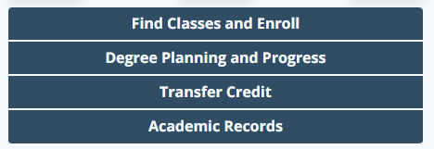
If 3rd attempt is needed
Talk to your academic advisor first
In LionPATH, submit the Course Repeat Form
Once approved, LionPATH will tell you the specific date to enroll
*The form must be submitted at least 10 university business days prior to the first day of classes of the semester for which the student wants to enroll

Slide 6
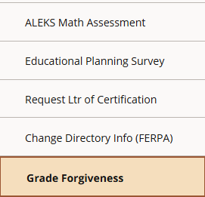
(Optional) After repeating the course
You can request Grade Forgiveness if your original grade was D/F
In LionPATH, go to Academic Records – Grade Forgiveness
More details at Grade Forgiveness.pptx

Slide 7
More Info
Penn State’s repeat policy is described under Policy C-7
Senate Policies: 47-00, 48-00, and 49-00 Grades

